Slide 1

Strategic Assessment of Butler Trail Traffic
Team: Aggieland Hackers
Gaurav Burman
Mayank Jaggi
Rohit Lilhare
Sumeet Shinde

Slide 2
Introduction
A comprehensive data driven solution for TTF
Value Propositions:
Forecasting
Short Term forecast (Daily/Weekly)
Long Term forecast (Quarterly)
Mean based Visualized Model
Workforce Planning Tool

Slide 3
Assumption
Only Crenshaw Bridge Trail used
Outliers(ACL and Kite Fest) were not considered in both ML models
Other city events don’t contribute significantly to spikes in counts
Every person is counted only once
NaNs and outliers are imputed by taking the mean of day of the week of past data

Slide 4
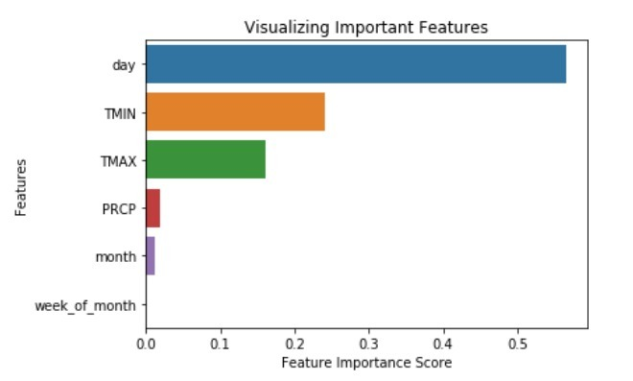
Random Forest (Daily/Weekly)
Important Features

Slide 5
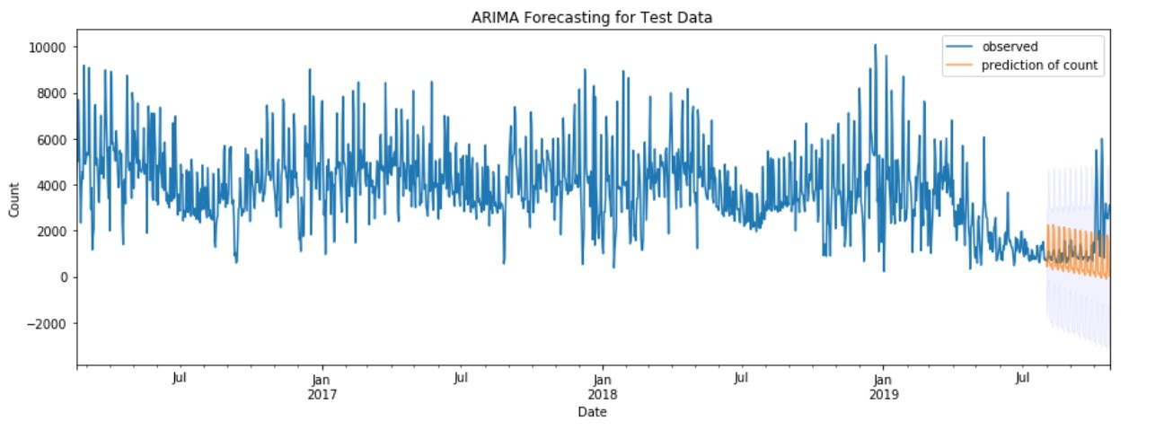
Time Series Model (Quarterly)
SARIMA((1,1,2) x (1,1,2)₇)

Slide 6
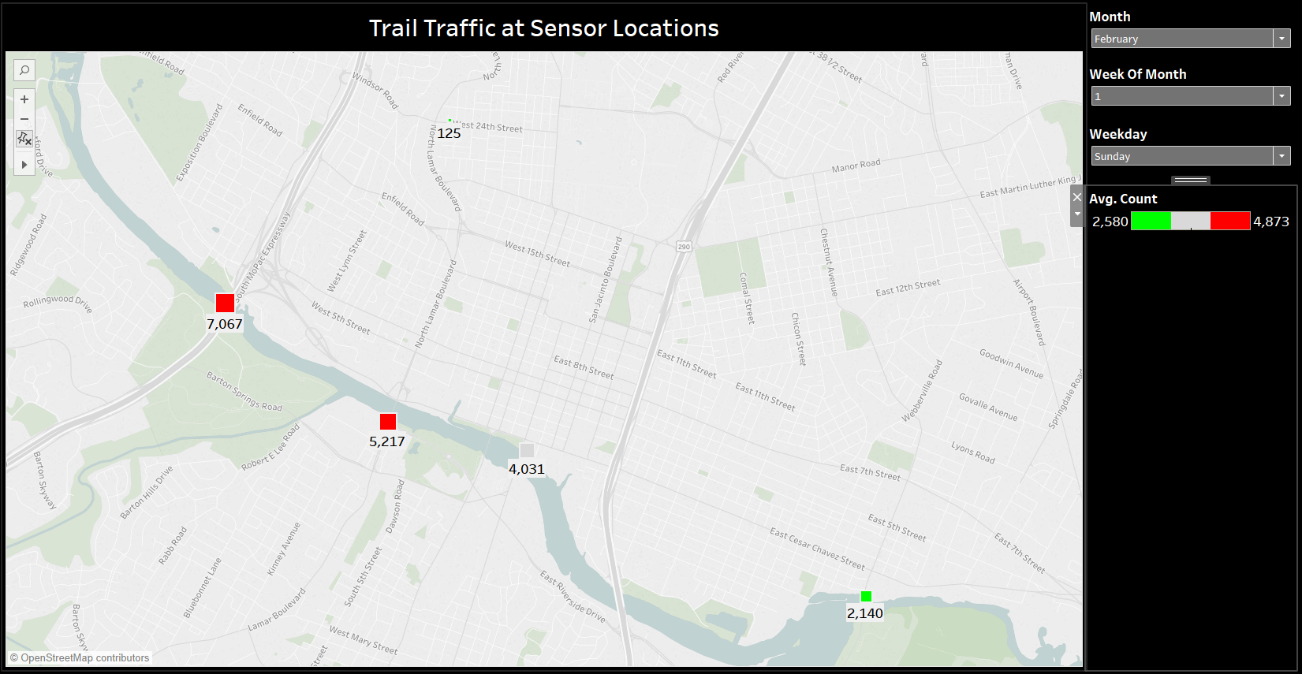
Mean based Visualized Model

Slide 7
Workforce Planning Tool
Chase Strategy
Constant Workforce Strategy

Slide 8
Questions?

